Slide 1
Data Structures & Algorithms
Lecture 1

Slide 2
Objectives
Understand the concept of data structure
Distinguish between data structures and data types
Learn how data structures are organized in the computer
Describe the characteristics of common types of data structures
Understand the concept of Abstract Data types
Describe the advantages of Abstract Data Types

Slide 3
Introduction to data structures
Study of various ways of organizing data in a computer.
Information is manipulated by systematic and step-by-step procedure called algorithms.
Manipulation involves adding, searching, deleting, rearranging data items.
Data Manipulation
Adding
Searching
Deleting
Rearranging
Sorting
Traversing

Slide 4
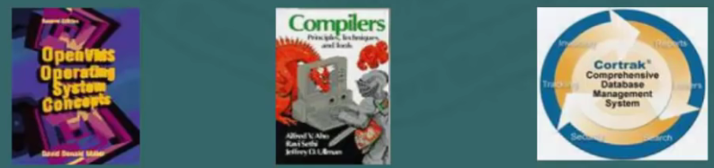
Introduction to data structures
Data structures are used in several disciplines:
Used by operating systems, compilers and database Management systems, data communications and so on

Slide 5

Introduction to data structures
Algorithms together with data structures are used in several applications.
Common applications are: image processing, digital signal processing, simulation, numerical computations, cryptography, data compressions and genetic studies.

Slide 6
Data types
Data types are required for efficient coding of programs.
Two types are primitive and composite
  Primitive data types includes Boolean, which stores logical value true and false
  Operations on Boolean data types include AND, OR and NOT
  Integer type can assume different set of values depending on compiler system.
  Basic operations on integers are arithmetic and comparison
  Primitive data types are also called atomic or irreducible

Slide 7
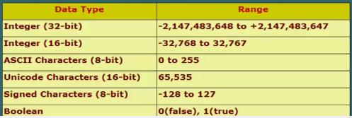
Data Types
Primitive Data Types
  Ranges of primitive data types depend on the number of bits allocated by the compiler and hardware circuitry.
  Typically an integer type ranges from -2, 147,483,648 to 2, 147,483,647
  Characters type can range from 0 to 65,000
  Operations on primitive types are often included in the CPU instruction set
  On some systems the primitive data types are implemented using software routines.

Slide 8
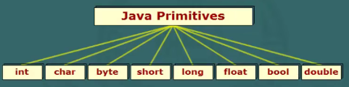
Data Types
Primitive Data Types
  Primitive data types are described in a program by language specific keywords
  E.g Java defines eight primitives

Slide 9
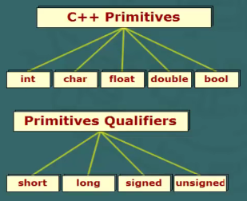
Data Types
Primitive Data Types
  C/C++ basic data types are int, float, char, double, short, long, signed, unsigned.
  Boolean type is not supported in C

Slide 10
Data Types
Composite Data Types
  Complex data types are defined using combination of primitive types
  Composite data types can be arrays, vectors and strings
    An array is a collection of homogeneous data types
    Vectors are mathematical representations of arrays.
    A string is a combination of characters

Slide 11
Data Structures
Primitive and composite data types are sufficient for solving simple problems.
The early computer applications depended on the built-in data types of programming languages.
Primitives types are not always sufficient to solve advanced problems
Need for advanced data types arose due to the new paradigm of object oriented approach.
Data structures was meant to serve these needs.

Slide 12
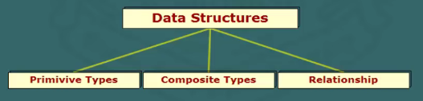
Data Structures
It is a programming construct that stores a collection of data items.
Data structure are not just an extension of composite data types.
Two significant different are
  First, data structures encompasses primitive and composite data types.
  Second, data structures it includes some kind of relationship among the data items
For example, string has definite order of organized characters.

Slide 13
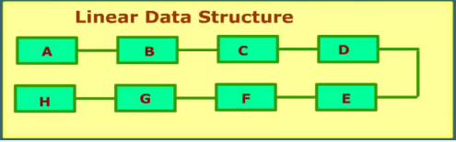
Data Structures
  Data structures are classified into two types: Linear and Non-Linear
  A structure in which data elements are organized in sequence is referred to as linear.

Slide 14


Data Structures: Linear
Examples are: arrays, linked lists, stacks and queues
Linked list consist of data items called nodes. Each data element contains two field; information field and a link field connected to another data items.
In a stack, last item added can be taken off first. Works on the principle of LIFO

Slide 15


Data structures: Linear
A queue is a data structure in which an item can be added at one end and removed from the other end. It works on the principle of FIFO
An array is a collection of homogeneous items

Slide 16
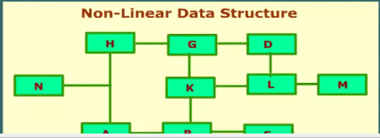
Data Structures: Non-Linear
Non Linear Data Structures
  Relationship among elements can be hierarchical: That is one element may be linked to more than one element in the collection.
  Linkage may be single or bi-directional;
  Non linear may also be referred to graph data structure

Slide 17
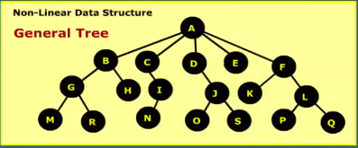
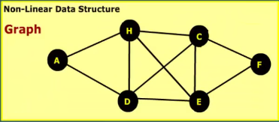
Data Structures: Non-Linear
Non-Linear Data Structure
  Common examples are: trees and graphs

Slide 18
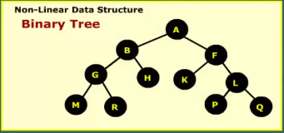
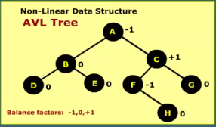
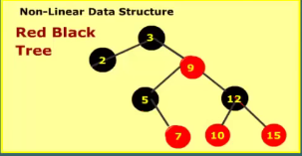
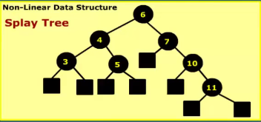
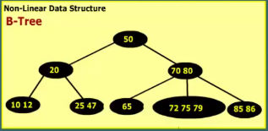
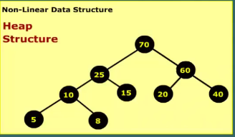
Data Structures:Non-Linear
A tree is a data structure that consists of a set of data items called nodes.
  It contains an information field and a link filed, which is address of related element
  There are variations of trees i.e binary, AVL, Red and Black, Splay, B-trees or heap

Slide 19
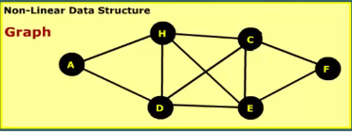
Data Structures: Non-Linear
Graph is a set of data items, called vertices or nodes, connected by links termed as edges or arcs

Slide 20
Operations on Data Structures
In order to process elements of a data structure some kind of operation is required.
A basic operation involves creating a data structure and reserving storage space for the elements.
Another operation is deleting the data structure, which removes the data items and releases the allocated storage space.
Other common operations are: inserting, sorting, searching, merging, traversing.

Slide 21
Operations on Data Structures
Inserting involves adding a data item in a specified position to the data structure.
sorting is arranging of data items in specific order.
Searching means finding an item which matches with a given key.
Merging involves combining two sets of data items with according to some criterion.
Traversing means accessing each element of a data structure at least once. Used particularly on graphs and also referred to as visiting of vertices on a graph.

Slide 22
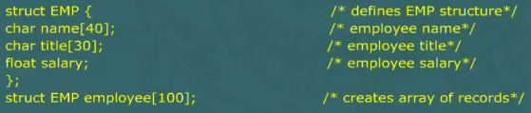
User-Defined Data Structures
Stacks, queues and trees are classical general purpose data structures.
Some programming languages such as JAVA provide built-in support for some of these structures.
We can also create our own data structures, which are called user-defined.
For example we can define a data structure to store records of 100 employees.
  Each record consist of employee’s name, designation and salary
  The code fragment in C might be as follows:
  The elements of employee array can be accessed using C notation as follows:
  Employ[0]. name, employ[0].title, employ[0].salary

Slide 23
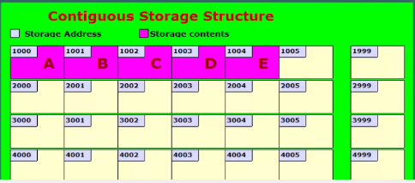
Storage structures
It describes how the data items are stored in the memory
It provides a map on how data elements are allocated memory space.
Elements are stored in consecutive or in disjoint storage locations
Each location is identified by unique number called memory address.

Slide 24
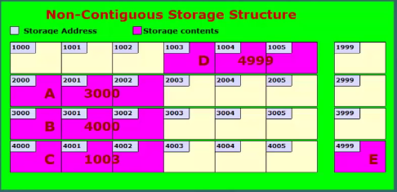
Storage structures
The figure shows contiguous allocation of storage space to a set of characters
To access any element, the address of the first element is needed.
Alternative it is possible to store elements in non- contiguous locations.
As shown in the figure character A,B,C are stored in non-contiguous locations

Slide 25
Storage structures
In order to establish relationship between A and B we find provided information somewhere about the location of B.
Each character is followed by the address of the next linked character.
For example character A is followed by integer 3000, which is the storage address of character B.

Slide 26
Abstract Data Types
An abstract Data Type (ADT) combines the description of the data structure, and associated operations.
ADT has the following characteristics:
  Provides a description of elements in terms of data types
  Defines relationship among individual elements
  Valid operations and parameters to be passed
  Error conditions associated with the operations

Slide 27
Abstract Data Types
For example an ADT stack can be defined by packaging together the following operations
  Push – insert an item into the stack
  Pop – Returns a data item from stack
  peek()- Returns top most element without removing it from the stack
  size() – Returns no elements currently in the stack
  isEmpty() – Returns true if stack is empty, and false otherwise.
Set of operations associated with ADT is called interface.
Elements of ADT data structure are manipulated through an interface

Slide 28
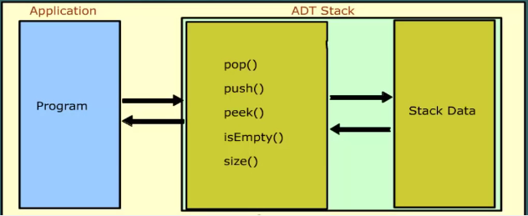
Abstract Data Types
The figure shows how elements of ADT are accessed using interface.
Implementation of operations and data items are hidden from the application program

Slide 29
Abstract Data Types
All built-in primitive data types are in fact abstract data types.
In floating point type, for example we cannot add a new operation, say, exponentiation.
We cannot enhance or shrink the set of allowed values.
ADT does not specify how the data structure would be coded.
It does not describe whether data elements are stored in consecutive or disjoint locations.
The implementation details are hidden from the application program.

Slide 30
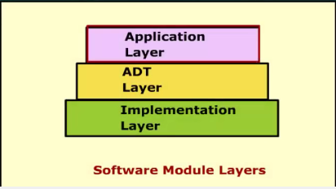
Abstract Data Types
In software module, an ADT can be viewed as layer between application that uses it and a component that implements ADT.
Some high level languages provide support for ADT in different ways.
  C has built-in struct type
  In C++, a class construct can be used
  In Java, an ADT can be expressed as Interface.

Slide 31
Advantages of ADT
Some advantages of ADT over the conventional data structures are
  ADT is reusable, robust, and is based of on principles of Object Oriented Programming (OOP) and software Engineering (SE)
  An ADT can be re-used at several places and it reduces coding efforts
  Encapsulation ensures that the data cannot be corrupted.
  Working of various integrated operations cannot be tampered with by the application program

Slide 32
Advantages of ADT
ADT approach is based on the SE concepts of coupling and cohesion
Coupling property determines
  How strongly two separate parts of program are linked together
  Extent to which change made in one part impacts the other parts of a software module.
Well- designed software has a minimum coupling
An ADT promotes weak coupling
Cohesion determines how well-integrated are components of software
An ADT inherently promotes maximum cohesion
All good software design will go for high cohesion and low coupling.

